Slide 1
Sequence Assembly
Fall 2016
BMI/CS 576
www.biostat.wisc.edu/bmi576/
Irene Ong
Irene.ong@wisc.edu

Slide 2
Outline
What Is Genome Sequencing?
Exploding Newspapers
The String Reconstruction Problem
String Reconstruction as a Hamiltonian Path Problem
String Reconstruction as an Eulerian Path Problem
Similar Problems with Different Fates
De Bruijn Graphs
Euler’s Theorem
Assembling Read-Pairs
De Bruijn Graphs Face Harsh Realities of Assembly

Slide 3
Representing a Genome as a Path
Composition₃(TAATGCCATGGGATGTT)=
TAA
AAT
ATG
TGC
GCC
CCA
CAT
ATG
TGG
GGG
GGA
GAT
ATG
TGT
GTT

Slide 4
Representing a Genome as a Path
Composition₃(TAATGCCATGGGATGTT)=
TAA
AAT
ATG
TGC
GCC
CCA
CAT
ATG
TGG
GGG
GGA
GAT
ATG
TGT
GTT

Slide 5
Representing a Genome as a Path
Composition₃(TAATGCCATGGGATGTT)=
TAA
AAT
ATG
TGC
GCC
CCA
CAT
ATG
TGG
GGG
GGA
GAT
ATG
TGT
GTT
Can we construct this genome path without knowing the genome TAATGCCATGGGATGTT, only from its composition?

Slide 6
Representing a Genome as a Path
Composition₃(TAATGCCATGGGATGTT)=
TAA
AAT
ATG
TGC
GCC
CCA
CAT
ATG
TGG
GGG
GGA
GAT
ATG
TGT
GTT
Can we construct this genome path without knowing the genome TAATGCCATGGGATGTT, only from its composition?
Yes. We simply need to connect k-mer₁ with k-mer₂ if suffix(k-mer₁)=prefix(k-mer₂).
E.g. TAA → AAT

Slide 7
A Path Turns into a Graph
TAATGCCATGGGATGTT
TAA
AAT
ATG
TGC
GCC
CCA
CAT
ATG
TGG
GGG
GGA
GAT
ATG
TGT
GTT
Yes. We simply need to connect k-mer₁ with k-mer₂ if suffix(k-mer₁)=prefix(k-mer₂).
E.g. TAA → AAT

Slide 8
A Path Turns into a Graph
TAATGCCATGGGATGTT
TAA
AAT
ATG
TGC
GCC
CCA
CAT
ATG
TGG
GGG
GGA
GAT
ATG
TGT
GTT
Can we still find the genome path in this graph?

Slide 9
A Path Turns into a Graph
TAATGCCATGGGATGTT
TAA
AAT
ATG
TGC
GCC
CCA
CAT
ATG
TGG
GGG
GGA
GAT
ATG
TGT
GTT
Can we still find the genome path in this graph?

Slide 10
Where Is the Genomic Path?
A Hamiltonian path: a path that visits each node in a graph exactly once.
TAA
T
G
C
C
A
T
G
G
G
A
T
G
T
T
AAT
ATG
ATG
ATG
CAT
CCA
GAT
GCC
GGA
GGG
GTT
TAA
TGC
TGG
TGT
What are we trying to find in this graph?
Nodes are arranged from left to right in lexicographic order.

Slide 11
TAA
T
G
G
G
A
T
G
C
C
A
T
G
T
T
AAT
ATG
ATG
ATG
CAT
CCA
GAT
GCC
GGA
GGG
GTT
TAA
TGC
TGG
TGT
TAA
T
G
C
C
A
T
G
G
G
A
T
G
T
T
AAT
ATG
ATG
ATG
CAT
CCA
GAT
GCC
GGA
GGG
GTT
TAA
TGC
TGG
TGT

Slide 12
Outline
What Is Genome Sequencing?
Exploding Newspapers
The String Reconstruction Problem
String Reconstruction as a Hamiltonian Path Problem
String Reconstruction as an Eulerian Path Problem
Similar Problems with Different Fates
De Bruijn Graphs
Euler’s Theorem
Assembling Read-Pairs
De Bruijn Graphs Face Harsh Realities of Assembly

Slide 13
A Slightly Different Path
TAATGCCATGGGATGTT
TAA
AAT
ATG
TGC
GCC
CCA
CAT
ATG
TGG
GGG
GGA
GAT
ATG
TGT
GTT
Instead of representing 3-mers as nodes
TAA
AAT
ATG
TGC
GCC
CCA
CAT
ATG
TGG
GGG
GGA
GAT
ATG
TGT
GTT
Let’s represent 3-mers as edges
How do we label the starting and ending nodes of an edge?
TAA
prefix of TAA
TA
AA
suffix of TAA

Slide 14
Labeling Nodes in the New Path
TAATGCCATGGGATGTT
TAA
AAT
ATG
TGC
GCC
CCA
CAT
ATG
TGG
GGG
GGA
GAT
ATG
TGT
GTT
3-mers as nodes
TAA
AAT
ATG
TGC
GCC
CCA
CAT
ATG
TGG
GGG
GGA
GAT
ATG
TGT
GTT
TA
AA
AT
TG
GC
CC
CA
AT
TG
GG
GG
GA
AT
TG
GT
TT
3-mers as edges and 2-mers as nodes

Slide 15
Labeling Nodes in the New Path
TAA
AAT
ATG
TGC
GCC
CCA
CAT
ATG
TGG
GGG
GGA
GAT
ATG
TGT
GTT
TA
AA
AT
TG
GC
CC
CA
AT
TG
GG
GG
GA
AT
TG
GT
TT
3-mers as edges and 2-mers as nodes

Slide 16
Gluing Identically Labeled Nodes
TAA
AAT
ATG
TGC
GCC
CCA
CAT
ATG
TGG
GGG
GGA
GAT
ATG
TGT
GTT
TA
AA
AT
TG
GC
CC
CA
AT
TG
GG
GG
GA
AT
TG
GT
TT
CC
CCA
GCC
CA
GC
CAT
TGC
AT
ATG
TG
TAA
AAT
TGG
GGG
GGA
GAT
ATG
TGT
GTT
TA
AA
AT
ATG
TG
GG
GG
GA
AT
TG
GT
TT

Slide 17
Gluing Identically Labeled Nodes
CC
TAATGCCATGGGATGTT
CCA
GCC
CA
GC
CAT
TGC
AT
ATG
TG
TAA
TA
AA
AT
ATG
TG
GT
TT
AAT
ATG
TGT
GTT
AT
TG
GAT
TGG
GA
GG
GGG
GGA
GG

Slide 18
Gluing Identically Labeled Nodes
CC
TAATGCCATGGGATGTT
CCA
GCC
CA
GC
CAT
TGC
ATG
TG
TAA
AT
TA
AA
AT
ATG
TG
GT
TT
AAT
AT
ATG
TGT
GTT
TG
GAT
TGG
GA
GG
GGG
GGA
GG

Slide 19
Gluing Identically Labeled Nodes
CC
TAATGCCATGGGATGTT
CCA
GCC
CA
GC
TGC
CAT
ATG
TG
TAA
AAT
TA
AA
AT
TG
GT
TT
ATG
TGT
GTT
ATG
GAT
TG
TGG
GA
GG
GGG
GGA
GG

Slide 20
Gluing Identically Labeled Nodes
CC
TAATGCCATGGGATGTT
CCA
GCC
CA
GC
TGC
CAT
ATG
TG
TAA
AAT
TA
AA
AT
TG
GT
TT
ATG
TGT
GTT
ATG
GAT
TG
TGG
GA
GG
GGG
GGA
GG

Slide 21
Gluing Identically Labeled Nodes
CC
TAATGCCATGGGATGTT
CCA
GCC
CA
GC
TGC
CAT
TAA
AAT
ATG
TG
TA
AA
AT
TG
GT
TT
ATG
TGT
GTT
ATG
TG
GAT
TGG
GA
GG
GGG
GGA
GG

Slide 22
Gluing Identically Labeled Nodes
CC
TAATGCCATGGGATGTT
CCA
GCC
CA
GC
TGC
CAT
TAA
AAT
ATG
TA
AA
AT
TG
GT
TT
ATG
TGT
GTT
ATG
GAT
TGG
GA
GG
GGG
GGA
GG

Slide 23
Gluing Identically Labeled Nodes
CC
TAATGCCATGGGATGTT
CCA
GCC
CA
GC
TGC
CAT
TAA
AAT
ATG
TA
AA
AT
TG
GT
TT
ATG
TGT
GTT
ATG
GAT
TGG
GA
GG
GGG
GGA
GG

Slide 24
Gluing Identically Labeled Nodes
CC
TAATGCCATGGGATGTT
CCA
GCC
CA
GC
TGC
CAT
TAA
AAT
ATG
TA
AA
AT
TG
GT
TT
ATG
TGT
GTT
ATG
GAT
TGG
GA
GG
GGG
GGA
GG

Slide 25
De Bruijn Graph of TAATGCCATGGGATGTT
CC
CCA
GCC
CA
GC
TGC
CAT
TAA
AAT
ATG
Where is the Genome
hiding in this graph?
TA
AA
AT
TG
GT
TT
ATG
TGT
GTT
ATG
GAT
TGG
GA
GG
GGA
GGG

Slide 26
It Was Always There!
TAA
T
G
C
C
A
T
G
G
G
A
T
G
T
T
CC
CCA
GCC
CA
GC
TGC
CAT
An Eulerian path in a graph is a path that visits each edge exactly once.
TAA
AAT
ATG
What are we trying to find in this graph?
TA
AA
AT
TG
GT
TT
ATG
TGT
GTT
ATG
GAT
TGG
GA
GG
GGA
GGG

Slide 27
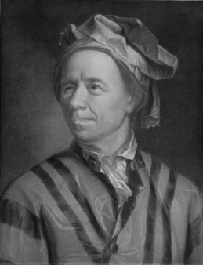
Eulerian Path Problem
Eulerian Path Problem. Find an Eulerian path in a graph.
Input. A graph.
Output. A path visiting every edge in the graph exactly once.

Slide 28
Outline
What Is Genome Sequencing?
Exploding Newspapers
The String Reconstruction Problem
String Reconstruction as a Hamiltonian Path Problem
String Reconstruction as an Eulerian Path Problem
Similar Problems with Different Fates
De Bruijn Graphs
Euler’s Theorem
Assembling Read-Pairs
De Bruijn Graphs Face Harsh Realities of Assembly

Slide 29
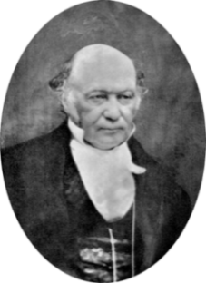
Eulerian Versus Hamiltonian Paths
Eulerian Path Problem. Find an Eulerian path in a graph.
Input. A graph.
Output. A path visiting every edge in the graph exactly once.
Hamiltonian Path Problem. Find a Hamiltonian path in a graph.
Input. A graph.
Output. A path visiting every node in the graph exactly once.

Slide 30
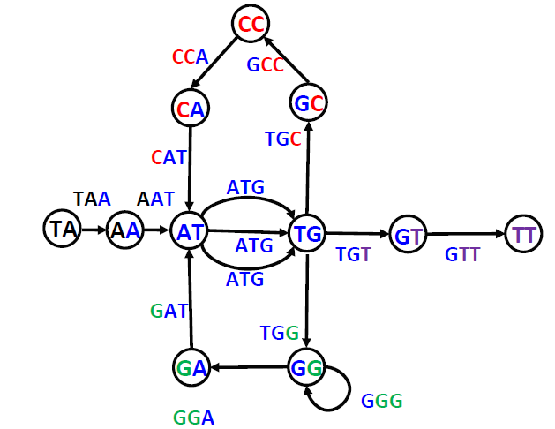
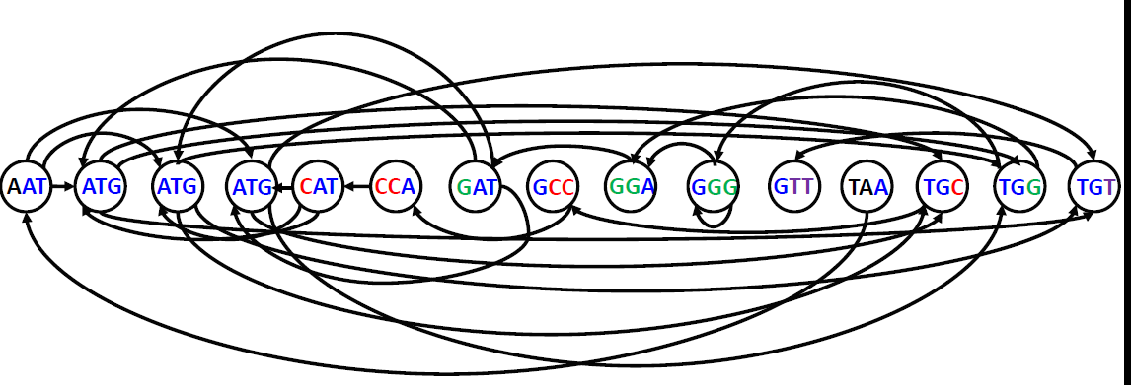
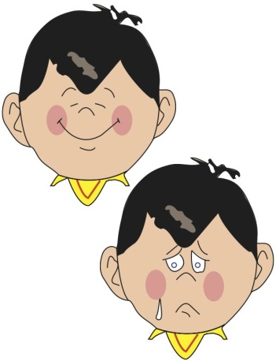
What Problem Would You Prefer to Solve?
Hamiltonian Path Problem
Eulerian Path Problem
While Euler solved the Eulerian Path Problem (even for a city with a million bridges), nobody has developed a fast algorithm for the Hamiltonian Path Problem yet.

Slide 31
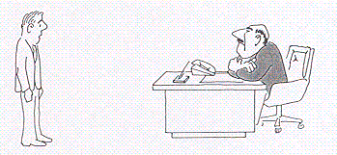
NP-Complete Problems
The Hamiltonian Path Problem belongs to a collection containing thousands of computational problems for which no fast algorithms are known.
“I can't find an efficient algorithm, I must not be working hard enough.”
From Garey and Johnson. Computers and Intractability. 1979

Slide 32

Change of Attitude
That would be an excellent argument, but the question of whether or not NP-Complete problems can be solved efficiently is one of seven Millennium Problems in mathematics.
“I can't find an efficient algorithm, because no such algorithm is possible.”
From Garey and Johnson. Computers and Intractability. 1979

Slide 33
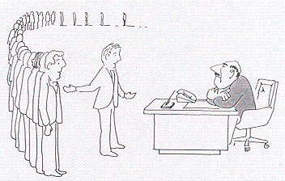
The Modern State of Affairs
NP-Complete problems are all equivalent: find an efficient solution to one, and you have an efficient solution to them all.
“I can't find an efficient algorithm, but neither can all these famous people.”

Slide 34
Outline
What Is Genome Sequencing?
Exploding Newspapers
The String Reconstruction Problem
String Reconstruction as a Hamiltonian Path Problem
String Reconstruction as an Eulerian Path Problem
Similar Problems with Different Fates
De Bruijn Graphs
Euler’s Theorem
Assembling Read-Pairs
De Bruijn Graphs Face Harsh Realities of Assembly

Slide 35
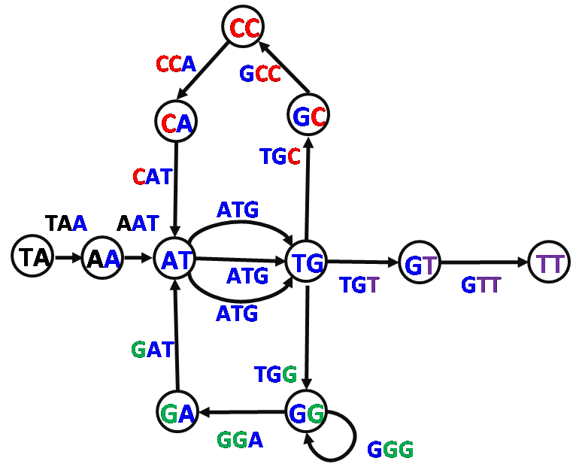
Eulerian Path Problem
Eulerian Path Problem. Find an Eulerian path in a graph.
Input. A graph.
Output. A path visiting every edge in the graph exactly once.
We constructed the de Bruijn graph from Genome, but in reality, Genome is unknown!

Slide 36
What We Have Done: From Genome to de Bruijn Graph
TAATGCCATGGGATGTT
CC
CCA
GCC
CA
GC
TGC
CAT
TAA
AAT
ATG
TA
AA
AT
TG
GT
TT
ATG
TGT
GTT
ATG
GAT
TGG
GA
GG
GGA
GGG

Slide 37
What We Want: From Reads (k-mers) to Genome
TAATGCCATGGGATGTT
AAT ATG ATG ATG CAT CCA GAT GCC GGA GGG GTT TAA TGC TGG TGT

Slide 38
What We will Show: From Reads to de Bruijn Graph to Genome
TAATGCCATGGGATGTT
CC
CCA
GCC
CA
GC
TGC
CAT
TAA
AAT
ATG
TA
AA
AT
TG
GT
TT
ATG
TGT
GTT
ATG
GAT
TGG
GA
GG
GGA
GGG
AAT ATG ATG ATG CAT CCA GAT GCC GGA GGG GTT TAA TGC TGG TGT

Slide 39
Constructing de Bruijn Graph when Genome Is Known
TAATGCCATGGGATGTT
TAA
AAT
ATG
TGC
GCC
CCA
CAT
ATG
TGG
GGG
GGA
GAT
ATG
TGT
GTT
TA
AA
AT
TG
GC
CC
CA
AT
TG
GG
GG
GA
AT
TG
GT
TT

Slide 40
Constructing de Bruijn when Genome Is Unknown
TAA
ATG
GCC
CAT
TGG
GGA
ATG
GTT
AAT
TGC
CCA
ATG
GGG
GAT
TGT
Composition₃(TAATGCCATGGGATGTT)

Slide 41
Representing Composition as a Graph Consisting of Isolated Edges
TAA
ATG
GCC
CAT
TGG
GGA
ATG
GTT
AAT
TGC
CCA
ATG
GGG
GAT
TGT
Composition₃(TAATGCCATGGGATGTT)

Slide 42
Constructing de Bruijn Graph from k-mer Composition
TAA
ATG
GCC
CAT
TGG
GGA
ATG
GTT
TA
AA
AT
TG
GC
CC
CA
AT
TG
GG
GG
GA
AT
TG
GT
TT
AAT
TGC
CCA
ATG
GGG
GAT
TGT
AA
AT
TG
GC
CC
CA
AT
TG
GG
GG
GA
AT
TG
GT
Composition₃(TAATGCCATGGGATGTT)

Slide 43
Gluing Identically Labeled Nodes
TAA
ATG
GCC
CAT
TGG
GGA
ATG
GTT
TA
AA
AT
TG
GC
CC
CA
AT
TG
GG
GG
GA
AT
TG
GT
TT
AAT
TGC
CCA
ATG
GGG
GAT
TGT
AA
AT
TG
GC
CC
CA
AT
TG
GG
GG
GA
AT
TG
GT

Slide 44
Gluing Identically Labeled Nodes
TAA
ATG
GCC
CAT
TGG
GGA
ATG
GTT
TA
AA
AT
TG
GC
CC
CA
AT
TG
GG
GG
GA
AT
TG
GT
TT
AA
AAT
TGC
CCA
ATG
GGG
GAT
TGT
AT
TG
GC
CC
CA
AT
TG
GG
GG
GA
AT
TG
GT

Slide 45
TAA
ATG
GCC
CAT
TGG
GGA
ATG
GTT
TA
AA
AT
TG
GC
CC
CA
AT
TG
GG
GG
GA
AT
TG
GT
TT
AAT
TGC
CCA
ATG
GGG
GAT
TGT
AT
TG
GC
CC
CA
AT
TG
GG
GG
GA
AT
TG
GT

Slide 46
TAA
ATG
GCC
CAT
TGG
GGA
ATG
GTT
TA
AA
AT
TG
GC
CC
CA
AT
TG
GG
GG
GA
AT
TG
GT
TT
AAT
TGC
CCA
ATG
GGG
GAT
TGT
AT
TG
GC
CC
CA
AT
TG
GG
GG
GA
AT
TG
GT

Slide 47
TAA
AAT
ATG
GCC
CAT
TGG
GGA
ATG
GTT
TA
AA
AT
TG
GC
CC
CA
AT
TG
GG
GG
GA
AT
TG
GT
TT
TGC
CCA
ATG
GGG
GAT
TGT
TG
GC
CC
CA
AT
TG
GG
GG
GA
AT
TG
GT

Slide 48
TAA
AAT
ATG
GCC
CAT
TGG
GGA
ATG
GTT
TA
AA
AT
TG
GC
CC
CA
AT
TG
GG
GG
GA
AT
TG
GT
TT
TGC
CCA
ATG
GGG
GAT
TGT
TG
GC
CC
CA
AT
TG
GG
GG
GA
AT
TG
GT

Slide 49
TAA
AAT
ATG
GCC
CAT
TGG
GGA
ATG
GTT
TA
AA
AT
TG
GC
CC
CA
AT
TG
GG
GG
GA
AT
TG
GT
TT
TGC
CCA
ATG
GGG
GAT
TGT
GC
CC
CA
AT
TG
GG
GG
GA
AT
TG
GT

Slide 50
TAA
AAT
ATG
GCC
CAT
TGG
GGA
ATG
GTT
TA
AA
AT
TG
GC
CC
CA
AT
TG
GG
GG
GA
AT
TG
GT
TT
TGC
CCA
ATG
GGG
GAT
TGT
GC
CC
CA
AT
TG
GG
GG
GA
AT
TG
GT

Slide 51
TAA
AAT
ATG
TGC
GCC
CAT
TGG
GGA
ATG
GTT
TA
AA
AT
TG
GC
CC
CA
AT
TG
GG
GG
GA
AT
TG
GT
TT
CCA
ATG
GGG
GAT
TGT
CC
CA
AT
TG
GG
GG
GA
AT
TG
GT

Slide 52
TAA
AAT
ATG
TGC
GCC
CAT
TGG
GGA
ATG
GTT
TA
AA
AT
TG
GC
CC
CA
AT
TG
GG
GG
GA
AT
TG
GT
TT
CCA
ATG
GGG
GAT
TGT
CC
CA
AT
TG
GG
GG
GA
AT
TG
GT

Slide 53
TAA
AAT
ATG
TGC
GCC
CAT
TGG
GGA
ATG
GTT
TA
AA
AT
TG
GC
CC
CA
AT
TG
GG
GG
GA
AT
TG
GT
TT
CCA
ATG
GGG
GAT
TGT
CA
AT
TG
GG
GG
GA
AT
TG
GT

Slide 54
TAA
AAT
ATG
TGC
GCC
CAT
TGG
GGA
ATG
GTT
TA
AA
AT
TG
GC
CC
CA
AT
TG
GG
GG
GA
AT
TG
GT
TT
CCA
ATG
GGG
GAT
TGT
CA
AT
TG
GG
GG
GA
AT
TG
GT

Slide 55
TAA
AAT
ATG
TGC
GCC
CCA
CAT
TGG
GGA
ATG
GTT
TA
AA
AT
TG
GC
CC
CA
AT
TG
GG
GG
GA
AT
TG
GT
TT
ATG
GGG
GAT
TGT
AT
TG
GG
GG
GA
AT
TG
GT

Slide 56
TAA
AAT
ATG
TGC
GCC
CCA
CAT
TGG
GGA
ATG
GTT
TA
AA
AT
TG
GC
CC
CA
AT
TG
GG
GG
GA
AT
TG
GT
TT
ATG
GGG
GAT
TGT
AT
TG
GG
GG
GA
AT
TG
GT

Slide 57
TAA
AAT
ATG
TGC
GCC
CCA
CAT
TGG
GGA
ATG
GTT
TA
AA
AT
TG
GC
CC
CA
AT
TG
GG
GG
GA
AT
TG
GT
TT
ATG
GGG
GAT
TGT
TG
GG
GG
GA
AT
TG
GT

Slide 58
TAA
AAT
ATG
TGC
GCC
CCA
CAT
TGG
GGA
ATG
GTT
TA
AA
AT
TG
GC
CC
CA
AT
TG
GG
GG
GA
AT
TG
GT
TT
ATG
GGG
GAT
TGT
TG
GG
GG
GA
AT
TG
GT

Slide 59
TAA
AAT
ATG
TGC
GCC
CCA
CAT
ATG
TGG
GGA
ATG
GTT
TA
AA
AT
TG
GC
CC
CA
AT
TG
GG
GG
GA
AT
TG
GT
TT
GGG
GAT
TGT
GG
GG
GA
AT
TG
GT

Slide 60
TAA
AAT
ATG
TGC
GCC
CCA
CAT
ATG
TGG
GGA
ATG
GTT
TA
AA
AT
TG
GC
CC
CA
AT
TG
GG
GG
GA
AT
TG
GT
TT
GGG
GAT
TGT
GG
GG
GA
AT
TG
GT

Slide 61
TAA
AAT
ATG
TGC
GCC
CCA
CAT
ATG
TGG
GGA
ATG
GTT
TA
AA
AT
TG
GC
CC
CA
AT
TG
GG
GG
GA
AT
TG
GT
TT
GGG
GAT
TGT
GG
GA
AT
TG
GT

Slide 62
TAA
AAT
ATG
TGC
GCC
CCA
CAT
ATG
TGG
GGA
ATG
GTT
TA
AA
AT
TG
GC
CC
CA
AT
TG
GG
GG
GA
AT
TG
GT
TT
GGG
GAT
TGT
GG
GA
AT
TG
GT

Slide 63
TAA
AAT
ATG
TGC
GCC
CCA
CAT
ATG
TGG
GGG
GGA
ATG
GTT
TA
AA
AT
TG
GC
CC
CA
AT
TG
GG
GG
GA
AT
TG
GT
TT
GAT
TGT
GA
AT
TG
GT

Slide 64
TAA
AAT
ATG
TGC
GCC
CCA
CAT
ATG
TGG
GGG
GGA
ATG
GTT
TA
AA
AT
TG
GC
CC
CA
AT
TG
GG
GG
GA
AT
TG
GT
TT
GAT
TGT
GA
AT
TG
GT

Slide 65
TAA
AAT
ATG
TGC
GCC
CCA
CAT
ATG
TGG
GGG
GGA
ATG
GTT
TA
AA
AT
TG
GC
CC
CA
AT
TG
GG
GG
GA
AT
TG
GT
TT
GAT
TGT
AT
TG
GT

Slide 66
TAA
AAT
ATG
TGC
GCC
CCA
CAT
ATG
TGG
GGG
GGA
ATG
GTT
TA
AA
AT
TG
GC
CC
CA
AT
TG
GG
GG
GA
AT
TG
GT
TT
GAT
TGT
AT
TG
GT

Slide 67
TAA
AAT
ATG
TGC
GCC
CCA
CAT
ATG
TGG
GGG
GGA
GAT
ATG
GTT
TA
AA
AT
TG
GC
CC
CA
AT
TG
GG
GG
GA
AT
TG
GT
TT
TGT
TG
GT

Slide 68
TAA
AAT
ATG
TGC
GCC
CCA
CAT
ATG
TGG
GGG
GGA
GAT
ATG
GTT
TA
AA
AT
TG
GC
CC
CA
AT
TG
GG
GG
GA
AT
TG
GT
TT
TGT
TG
GT

Slide 69
TAA
AAT
ATG
TGC
GCC
CCA
CAT
ATG
TGG
GGG
GGA
GAT
ATG
GTT
TA
AA
AT
TG
GC
CC
CA
AT
TG
GG
GG
GA
AT
TG
GT
TT
TGT
GT

Slide 70
TAA
AAT
ATG
TGC
GCC
CCA
CAT
ATG
TGG
GGG
GGA
GAT
ATG
GTT
TA
AA
AT
TG
GC
CC
CA
AT
TG
GG
GG
GA
AT
TG
GT
TT
TGT
GT

Slide 71
We Are Not Done with Gluing Yet
TAA
AAT
ATG
TGC
GCC
CCA
CAT
ATG
TGG
GGG
GGA
GAT
ATG
TGT
GTT
TA
AA
AT
TG
GC
CC
CA
AT
TG
GG
GG
GA
AT
TG
GT
TT

Slide 72
Gluing Identically Labeled Nodes
TAA
AAT
ATG
TGC
GCC
CCA
CAT
ATG
TGG
GGG
GGA
GAT
ATG
TGT
GTT
TA
AA
AT
TG
GC
CC
CA
AT
TG
GG
GG
GA
AT
TG
GT
TT
CC
CCA
GCC
CA
GC
CAT
TGC
AT
ATG
TG
TAA
AAT
TGG
GGG
GGA
GAT
ATG
TGT
GTT
TA
AA
AT
ATG
TG
GG
GG
GA
AT
TG
GT
TT

Slide 73
Gluing Identically Labeled Nodes
CC
TAATGCCATGGGATGTT
CCA
GCC
CA
GC
CAT
TGC
AT
ATG
TG
TAA
TA
AA
AT
ATG
TG
GT
TT
AAT
ATG
TGT
GTT
AT
TG
GAT
TGG
GA
GG
GGG
GGA
GG

Slide 74
CC
TAATGCCATGGGATGTT
CCA
GCC
CA
GC
CAT
TGC
ATG
TG
TAA
AT
TA
AA
AT
ATG
TG
GT
TT
AAT
AT
ATG
TGT
GTT
TG
GAT
TGG
GA
GG
GGG
GGA
GG

Slide 75
Gluing Identically Labeled Nodes
CC
TAATGCCATGGGATGTT
CCA
GCC
CA
GC
TGC
CAT
ATG
TG
TAA
AAT
TA
AA
AT
TG
GT
TT
ATG
TGT
GTT
ATG
GAT
TG
TGG
GA
GG
GGG
GGA
GG

Slide 76
Gluing Identically Labeled Nodes
CC
TAATGCCATGGGATGTT
CCA
GCC
CA
GC
TGC
CAT
ATG
TG
TAA
AAT
TA
AA
AT
TG
GT
TT
ATG
TGT
GTT
ATG
GAT
TG
TGG
GA
GG
GGG
GGA
GG

Slide 77
Gluing Identically Labeled Nodes
CC
TAATGCCATGGGATGTT
CCA
GCC
CA
GC
TGC
CAT
TAA
AAT
ATG
TG
TA
AA
AT
TG
GT
TT
ATG
TGT
GTT
ATG
TG
GAT
TGG
GA
GG
GGG
GGA
GG

Slide 78
Gluing Identically Labeled Nodes
CC
TAATGCCATGGGATGTT
CCA
GCC
CA
GC
TGC
CAT
TAA
AAT
ATG
TA
AA
AT
TG
GT
TT
ATG
TGT
GTT
ATG
GAT
TGG
GA
GG
GGG
GGA
GG

Slide 79
Gluing Identically Labeled Nodes
CC
TAATGCCATGGGATGTT
CCA
GCC
CA
GC
TGC
CAT
TAA
AAT
ATG
TA
AA
AT
TG
GT
TT
ATG
TGT
GTT
ATG
GAT
TGG
GA
GG
GGG
GGA
GG

Slide 80
Gluing Identically Labeled Nodes
CC
TAATGCCATGGGATGTT
CCA
GCC
CA
GC
TGC
CAT
TAA
AAT
ATG
TA
AA
AT
TG
GT
TT
ATG
TGT
GTT
ATG
GAT
TGG
GA
GG
GGG
GGA
GG

Slide 81
The Same de Bruijn Graph:
DeBruin(Genome)=DeBruin(Genome Composition)
CC
CCA
GCC
CA
GC
TGC
CAT
TAA
AAT
ATG
TA
AA
AT
TG
GT
TT
ATG
TGT
GTT
ATG
GAT
TGG
GA
GG
GGA
GGG

Slide 82
Constructing de Bruijn Graph
De Bruijn graph of a collection of k-mers:
Represent every k-mer as an edge between its prefix and suffix
Glue ALL nodes with identical labels.
DeBruijn(k-mers)
form a node for each (k-1)-mer from k-mers
for each k-mer in k-mers
connect its prefix node with its suffix node by an edge

Slide 83
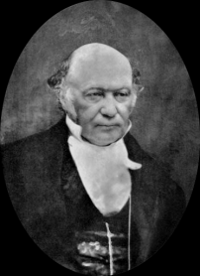
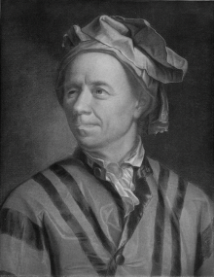
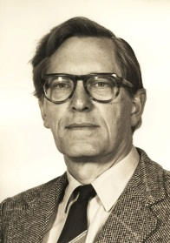
From Hamilton to Euler to de Bruijn
Universal String Problem (De Bruijn, 1946). Find a circular string containing each binary k-mer exactly once.

Slide 84
From Hamilton to Euler to de Bruijn
Universal String Problem (De Bruijn, 1946). Find a circular string containing each binary k-mer exactly once.
000 001 010 011 100 101 110 111
0
0
1
0
0
1
1
1

Slide 85
From Hamilton to Euler to de Bruijn
Universal String Problem (Nicolaas de Bruijn, 1946). Find a circular string containing each binary k-mer exactly once.
000 001 010 011 100 101 110 111
0
0
1
0
0
1
1
1

Slide 86
From Hamilton to Euler to de Bruijn
Universal String Problem (Nicolaas de Bruijn, 1946). Find a circular string containing each binary k-mer exactly once.
000 001 010 011 100 101 110 111
000
001
010
011
100
101
110
111
00
00
00
01
01
10
01
11
10
00
10
01
11
10
11
11
00
01
10
11

Slide 87
From Hamilton to Euler to de Bruijn
0
0
00
01
1
0
0
1
10
11
1
1

Slide 88
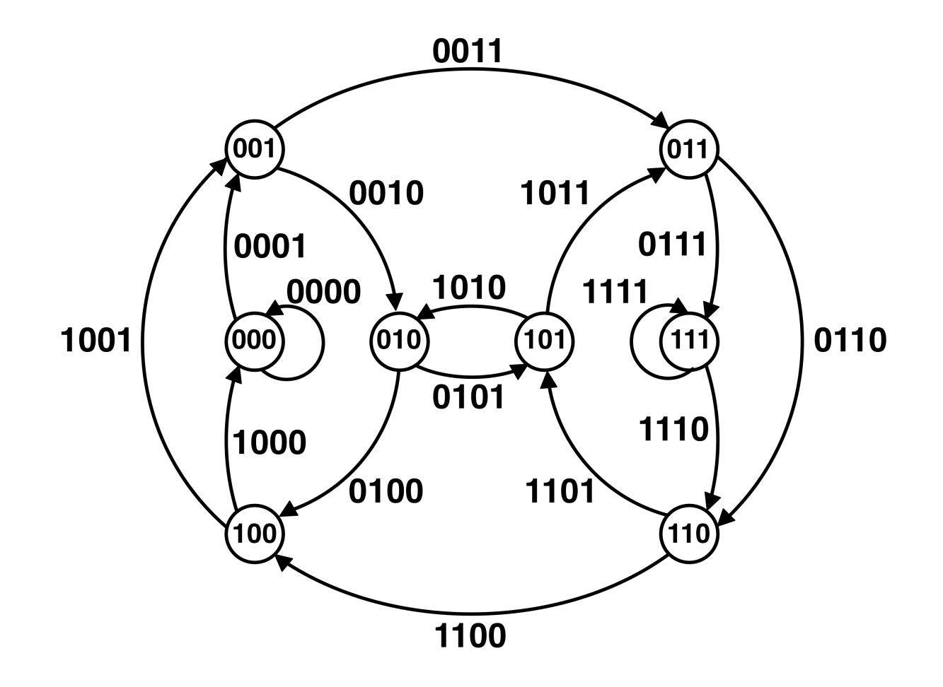
De Bruijn Graph for 4-Universal String
Does it have an Eulerian cycle? If yes, how can we find it?

Slide 89
Outline
What Is Genome Sequencing?
Exploding Newspapers
The String Reconstruction Problem
String Reconstruction as a Hamiltonian Path Problem
String Reconstruction as an Eulerian Path Problem
Similar Problems with Different Fates
De Bruijn Graphs
Euler’s Theorem
Assembling Read-Pairs
De Bruijn Graphs Face Harsh Realities of Assembly

Slide 90
Eulerian CYCLE Problem
Eulerian CYCLE Problem. Find an Eulerian cycle in a graph.
Input. A graph.
Output. A cycle visiting every edge in the graph exactly once.

Slide 91
A Graph is Eulerian if It Contains an Eulerian Cycle.
Is this graph Eulerian?

Slide 92
A Graph is Eulerian if It Contains an Eulerian Cycle.
Is this graph Eulerian?
1 in, 2 out
A graph is balanced if indegree = outdegree for each node

Slide 93
Is the Graph for 4-Universal String Balanced?

Slide 94
Euler’s Theorem
Every Eulerian graph is balanced

Slide 95
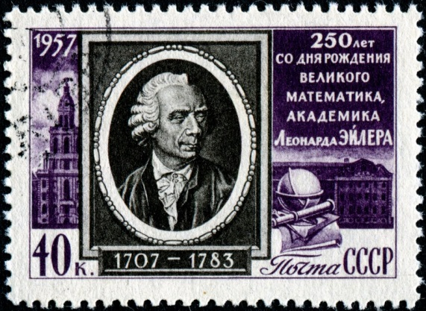
Euler’s Theorem
Every Eulerian graph is balanced
Every balanced* graph is Eulerian
(*) and strongly connected, of course!

Slide 96
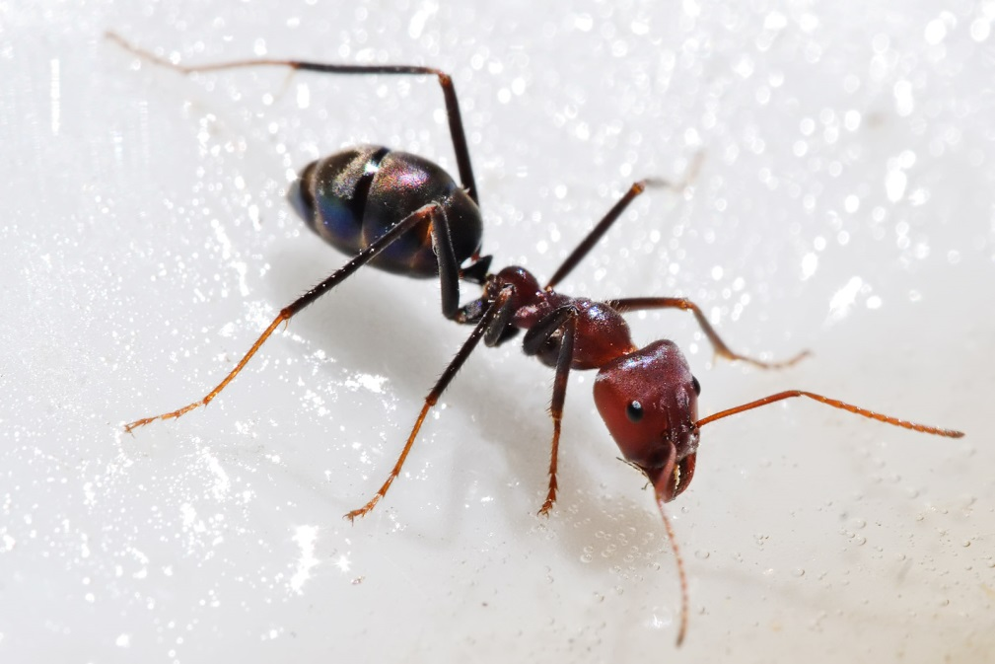
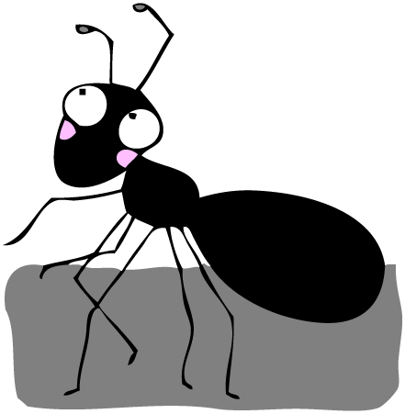
Recruiting an Ant to Prove Euler’s Theorem
Let an ant randomly walk through the graph. The ant cannot use the same edge twice!

Slide 97
If Ant Was a Genius…
“Yay! Now can I go home please?”

Slide 98
A Less Intelligent Ant Would Randomly Choose a Node and Start Walking…

Slide 99
Walking…

Slide 100
Walking… and Walking…

Slide 101
Walking… and Walking… and Walking…
Can it get stuck? In what node?

Slide 102
The Ant Can Only Get Stuck at the Starting Node

Slide 103
The Ant Has Completed a Cycle BUT has not Proven Euler’s theorem yet…
The constructed cycle is not Eulerian. Can we enlarge it?

Slide 104
Let’s Start at a Different Node in the Green Cycle
Let’s start at a node with still unexplored edges.
“Why should I start at a different node? Backtracking? I’m not evolved to walk backwards! And what difference does it make???”

Slide 105
New Instructions for the Ant:
Starting at a node that has an unused edge, traverse the already constructed (green cycle) and return back to the starting node.

Slide 106
An Ant Traversing Previously Constructed Cycle
Starting at a node that has an unused edge, traverse the already constructed (green cycle) and return back to the starting node.
1

Slide 107
An Ant Traversing Previously Constructed Cycle
Starting at a node that has an unused edge, traverse the already constructed (green cycle) and return back to the starting node.
2
1

Slide 108
An Ant Traversing Previously Constructed Cycle
Starting at a node that has an unused edge, traverse the already constructed (green cycle) and return back to the starting node.
2
“Why do I have to walk along the same cycle again??? Can I see something new?”
3
1

Slide 109
I Returned Back BUT… I Can Continue Walking!
Starting at a node that has an unused edge, traverse the already constructed (green cycle) and return back to the starting node.
After completing the cycle, start random exploration of still untraversed edges in the graph.
2
3
1
4

Slide 110
Enlarging the Previously Constructed Cycle

Slide 111
Enlarging the Previously Constructed Cycle

Slide 112
Enlarging the Previously Constructed Cycle

Slide 113
Enlarging the Previously Constructed Cycle

Slide 114
Stuck Again!
No Eulerian cycle yet… can we enlarge the green-blue cycle?
The ant should walk along the constructed cycle starting at yet another node. Which one?
6
7
2
8
3
5
1
4

Slide 115
Starting at a New Node, Again…

Slide 116
Traversing the Previously Constructed Green-Blue Cycle
1

Slide 117
Traversing the Previously Constructed Green-Blue Cycle
1
2

Slide 118
Traversing the Previously Constructed Green-Blue Cycle
“I hate to traverse the same cycle! What difference does it make where I start my walk???
1
3
2

Slide 119
Traversing the Previously Constructed Green-Blue Cycle
1
3
4
2
“These instructions are stupid…”

Slide 120
Traversing the Previously Constructed Green-Blue Cycle
1
3
4
2
5

Slide 121
Traversing the Previously Constructed Green-Blue Cycle
1
3
4
6
2
5

Slide 122
Traversing the Previously Constructed Green-Blue Cycle
7
1
3
4
6
2
5

Slide 123
I Returned Back BUT… I Can Continue Walking!
“Hmm, maybe these instructions were not that stupid…”
7
8
1
3
4
6
2
5

Slide 124
Enlarging the Green-Blue Cycle

Slide 125
Enlarging the Green-Blue Cycle

Slide 126
I Proved Euler’s Theorem! Can I Go Home Please?
EulerianCycle(BalancedGraph)
form a Cycle by randomly walking in BalancedGraph (avoiding already visited edges)
while Cycle is not Eulerian
select a node newStart in Cycle with still unexplored outgoing edges
form a Cycle’ by traversing Cycle from newStart and randomly walking afterwards
Cycle ← Cycle’
return Cycle
9
7
8
10
11
3
1
6
4
2
5

Slide 127
Outline
What Is Genome Sequencing?
Exploding Newspapers
The String Reconstruction Problem
String Reconstruction as a Hamiltonian Path Problem
String Reconstruction as an Eulerian Path Problem
Similar Problems with Different Fates
De Bruijn Graphs
Euler’s Theorem
Assembling Read-Pairs
De Bruijn Graphs Face Harsh Realities of Assembly

Slide 128
From Reads to de Bruijn Graph to Genome
TAATGCCATGGGATGTT
CC
CCA
GCC
CA
GC
TGC
CAT
TAA
AAT
ATG
TA
AA
AT
TG
GT
TT
ATG
TGT
GTT
ATG
GAT
TGG
GA
GG
GGA
GGG
AAT ATG ATG ATG CAT CCA GAT GCC GGA GGG GTT TAA TGC TGG TGT

Slide 129
Multiple Eulerian Paths
TAA
T
G
G
G
A
T
G
C
C
A
T
G
T
TAA
T
T
G
C
C
A
T
G
G
G
A
T
G
T
T
CC
CC
CCA
GCC
CCA
GCC
CA
GC
CA
GC
TGC
TGC
CAT
CAT
TAA
AAT
ATG
TAA
AAT
ATG
TA
AA
AT
TG
GT
TT
TA
AA
AT
TG
GT
TT
ATG
TGT
GTT
ATG
TGT
GTT
ATG
ATG
GAT
GAT
TGG
TGG
GA
GG
GA
GG
GGA
GGG
GGA
GGG

Slide 130
Breaking Genome into Contigs
TAA
T
G
C
C
A
T
G
G
G
A
T
G
T
T
CC
CCA
GCC
TGCCAT
CA
GC
TGC
ATG
TAA
AAT
ATG
TA
AA
AT
AT
AT
AT
AT
AT
TG
TG
TG
TG
TG
ATG
TG
GT
TT
TGT
GTT
TAAT
ATG
TGTT
TGG
TGG
TGG
GA
GG
GG
GGGAT
GG
GGA
GGG
GGG

Slide 131
DNA Sequencing with Read-pairs
Multiple identical copies of genome
Randomly cut genomes into large equally sized fragments of size InsertLength
Generate read-pairs: two reads from the ends of each fragment (separated by a fixed distance)
200 bp
200 bp
InsertLength

Slide 132
From k-mers to Paired k-mers
Read 1
Read 2
Genome
...A T C A G A T T A C G T T C C G A G …
Distance d=11
A paired k-mer is a pair of k-mers at a fixed distance d apart in Genome. E.g. TCA and TCC are at distance d=11 apart.
Disclaimers:
1. In reality, Read1 and Read2 are typically sampled from different strands:
(→ ……. ← rather than → ……. →)
2. In reality, the distance d between reads is measured with errors.

Slide 133
What is PairedComposition(TAATGCCATGGGATGTT)?
TAA GCC
paired 3-mer
Show first line first
And then show all the lines

Slide 134
What is PairedComposition(TAATGCCATGGGATGTT)?
TAA GCC
AAT CCA
ATG CAT
TGC ATG
GCC TGG
CCA GGG
CAT GGA
ATG GAT
TGG ATG
GGG TGT
GGA GTT
Show first line first
And then show all the lines
Representing a paired 3-mer TAA GCC as a 2-line expression:
TAA
GCC
TAA
GCC
AAT
CCA
ATG
CAT
TGC
ATG
GCC
TGG
CCA
GGG
CAT
GGA
ATG
GAT
TGG
ATG
GGG
TGT
GGA
GTT

Slide 135
PairedComposition(TAATGCCATGGGATGTT)
TAA GCC
AAT CCA
ATG CAT
TGC ATG
GCC TGG
CCA GGG
CAT GGA
ATG GAT
TGG ATG
GGG TGT
GGA GTT
Show first line first
And then show all the lines
TAA
GCC
AAT
CCA
ATG
CAT
TGC
ATG
GCC
TGG
CCA
GGG
CAT
GGA
ATG
GAT
TGG
ATG
GGG
TGT
GGA
GTT
AAT
CCA
ATG
CAT
ATG
GAT
CAT
GGA
CCA
GGG
GCC
TGG
GGA
GTT
GGG
TGT
TAA
GCC
TGC
ATG
TGG
ATG
Representing PairedComposition in lexicographic order

Slide 136
String Reconstruction from Read-Pairs Problem
String Reconstruction from Read-Pairs Problem. Reconstruct a string from its paired k-mers.
Input. A collection of paired k-mers.
Output. A string Text such that PairedComposition(Text) is equal to the collection of paired k-mers.

Slide 137
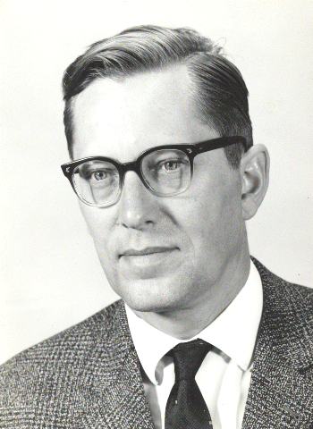
How Would de Bruijn Assemble Paired k-mers?

Slide 138
Paired de Bruijn Graphs

Slide 139
Representing Genome TAATGCCATGGGATGTT as a Path
TAA GCC
AAT CCA
ATG CAT
TGC ATG
GCC TGG
CCA GGG
CAT GGA
ATG GAT
TGG ATG
GGG TGT
GGA GTT
TAA
GCC
AAT
CCA
ATG
CAT
TGC
ATG
GCC
TGG
CCA
GGG
CAT
GGA
ATG
GAT
TGG
ATG
GGG
TGT
GGA
GTT
CCA
GGG
paired prefix of → ← paired suffix of
CCA
GGG
CC
GG
CA
GG
CCA
GGG

Slide 140
Labeling Nodes by Paired Prefixes and Suffixes
TAA
GCC
AAT
CCA
ATG
CAT
TGC
ATG
GCC
TGG
CCA
GGG
CAT
GGA
ATG
GAT
TGG
ATG
GGG
TGT
GGA
GTT
TA
GC
AA
CC
AT
CA
TG
AT
GC
TG
CC
GG
CA
GG
AT
GA
TG
AT
GG
TG
GG
GT
GA
TT
CCA
GGG
paired prefix of → ← paired suffix of
CCA
GGG
CC
GG
CA
GG
CCA
GGG

Slide 141
Glue nodes with identical labels
TAA
GCC
AAT
CCA
ATG
CAT
TGC
ATG
GCC
TGG
CCA
GGG
CAT
GGA
ATG
GAT
TGG
ATG
GGG
TGT
GGA
GTT
TA
GC
AA
CC
AT
CA
TG
AT
GC
TG
CC
GG
CA
GG
AT
GA
TG
AT
GG
TG
GG
GT
GA
TT

Slide 142
Glue nodes with identical labels
TAA
GCC
AAT
CCA
ATG
CAT
TGC
ATG
GCC
TGG
CCA
GGG
CAT
GGA
ATG
GAT
TGG
ATG
GGG
TGT
GGA
GTT
TA
GC
AA
CC
AT
CA
TG
AT
GC
TG
CC
GG
CA
GG
AT
GA
TG
AT
GG
TG
GG
GT
GA
TT
GCC
TGG
CCA
GGG
CAT
GGA
TGC
ATG
GC
TG
CC
GG
CA
GG
AT
GA
TAA
GCC
AAT
CCA
ATG
CAT
ATG
GAT
TA
GC
AA
CC
AT
CA
TG
AT
TG
AT
GG
TG
GG
GT
GA
TT
TGG
ATG
GGG
TGT
GGA
GTT

Slide 143
Glue nodes with identical labels
TAA
GCC
AAT
CCA
ATG
CAT
TGC
ATG
GCC
TGG
CCA
GGG
CAT
GGA
ATG
GAT
TGG
ATG
GGG
TGT
GGA
GTT
TA
GC
AA
CC
AT
CA
TG
AT
GC
TG
CC
GG
CA
GG
AT
GA
TG
AT
GG
TG
GG
GT
GA
TT
GCC
TGG
CCA
GGG
CAT
GGA
TGC
ATG
GC
TG
CC
GG
CA
GG
AT
GA
TAA
GCC
AAT
CCA
ATG
CAT
ATG
GAT
TA
GC
AA
CC
AT
CA
TG
AT
GG
TG
GG
GT
GA
TT
TGG
ATG
GGG
TGT
GGA
GTT
Paired de Bruijn Graph from the Genome

Slide 144
Constructing Paired de Bruijn Graph from paired k-mers
TAA
GCC
ATG
CAT
GCC
TGG
CAT
GGA
TGG
ATG
GGA
GTT
AAT
CCA
TGC
ATG
CCA
GGG
ATG
GAT
GGG
TGT

Slide 145
Constructing Paired de Bruijn Graph from paired k-mers
TAA
GCC
ATG
CAT
GCC
TGG
CAT
GGA
TGG
ATG
GGA
GTT
AAT
CCA
TGC
ATG
CCA
GGG
ATG
GAT
GGG
TGT
CCA
GGG
paired prefix of → ← paired suffix of
CCA
GGG
CC
GG
CA
GG
CCA
GGG

Slide 146
Constructing Paired de Bruijn Graph
TAA
GCC
ATG
CAT
GCC
TGG
CAT
GGA
TGG
ATG
GGA
GTT
TA
GC
AA
CC
AT
CA
TG
AT
GC
TG
CC
GG
CA
GG
AT
GA
TG
AT
GG
TG
GG
GT
GA
TT
AAT
CCA
TGC
ATG
CCA
GGG
ATG
GAT
GGG
TGT
AA
CC
AT
CA
TG
AT
GC
TG
CC
GG
CA
GG
AT
GA
TG
AT
GG
TG
GG
GT
CCA
GGG
paired prefix of → ← paired suffix of
CCA
GGG
CC
GG
CA
GG
CCA
GGG

Slide 147
Constructing Paired de Bruijn Graph
TAA
GCC
ATG
CAT
GCC
TGG
CAT
GGA
TGG
ATG
GGA
GTT
TA
GC
AA
CC
AT
CA
TG
AT
GC
TG
CC
GG
CA
GG
AT
GA
TG
AT
GG
TG
GG
GT
GA
TT
AAT
CCA
TGC
ATG
CCA
GGG
ATG
GAT
GGG
TGT
AA
CC
AT
CA
TG
AT
GC
TG
CC
GG
CA
GG
AT
GA
TG
AT
GG
TG
GG
GT
Paired de Bruijn graph for a collection of paired k-mers:
Represent every paired k-mer as an edge between its paired prefix and paired suffix.
Glue ALL nodes with identical labels.

Slide 148
Constructing Paired de Bruijn Graph
TAA
GCC
ATG
CAT
GCC
TGG
CAT
GGA
TGG
ATG
GGA
GTT
TA
GC
AA
CC
AT
CA
TG
AT
GC
TG
CC
GG
CA
GG
AT
GA
TG
AT
GG
TG
GG
GT
GA
TT
AAT
CCA
TGC
ATG
CCA
GGG
ATG
GAT
GGG
TGT
AA
CC
AT
CA
TG
AT
GC
TG
CC
GG
CA
GG
AT
GA
TG
AT
GG
TG
GG
GT

Slide 149
Constructing Paired de Bruijn Graph
TAA
GCC
ATG
CAT
GCC
TGG
CAT
GGA
TGG
ATG
GGA
GTT
TA
GC
AA
CC
AT
CA
TG
AT
GC
TG
CC
GG
CA
GG
AT
GA
TG
AT
GG
TG
GG
GT
GA
TT
AAT
CCA
TGC
ATG
CCA
GGG
ATG
GAT
GGG
TGT
AT
CA
TG
AT
GC
TG
CC
GG
CA
GG
AT
GA
TG
AT
GG
TG
GG
GT

Slide 150
Constructing Paired de Bruijn Graph
TAA
GCC
AAT
CCA
ATG
CAT
GCC
TGG
CAT
GGA
TGG
ATG
GGA
GTT
TA
GC
AA
CC
AT
CA
TG
AT
GC
TG
CC
GG
CA
GG
AT
GA
TG
AT
GG
TG
GG
GT
GA
TT
TGC
ATG
CCA
GGG
ATG
GAT
GGG
TGT
TG
AT
GC
TG
CC
GG
CA
GG
AT
GA
TG
AT
GG
TG
GG
GT

Slide 151
Constructing Paired de Bruijn Graph
TAA
GCC
AAT
CCA
ATG
CAT
GCC
TGG
CAT
GGA
TGG
ATG
GGA
GTT
TA
GC
AA
CC
AT
CA
TG
AT
GC
TG
CC
GG
CA
GG
AT
GA
TG
AT
GG
TG
GG
GT
GA
TT
TGC
ATG
CCA
GGG
ATG
GAT
GGG
TGT
GC
TG
CC
GG
CA
GG
AT
GA
TG
AT
GG
TG
GG
GT

Slide 152
Constructing Paired de Bruijn Graph
TAA
GCC
AAT
CCA
ATG
CAT
GCC
TGG
CAT
GGA
TGG
ATG
GGA
GTT
TA
GC
AA
CC
AT
CA
TG
AT
GC
TG
CC
GG
CA
GG
AT
GA
TG
AT
GG
TG
GG
GT
GA
TT
TGC
ATG
CCA
GGG
ATG
GAT
GGG
TGT
GC
TG
CC
GG
CA
GG
AT
GA
TG
AT
GG
TG
GG
GT

Slide 153
Constructing Paired de Bruijn Graph
TAA
GCC
AAT
CCA
ATG
CAT
TGC
ATG
GCC
TGG
CAT
GGA
TGG
ATG
GGA
GTT
TA
GC
AA
CC
AT
CA
TG
AT
GC
TG
CC
GG
CA
GG
AT
GA
TG
AT
GG
TG
GG
GT
GA
TT
CCA
GGG
ATG
GAT
GGG
TGT
CC
GG
CA
GG
AT
GA
TG
AT
GG
TG
GG
GT

Slide 154
Constructing Paired de Bruijn Graph
TAA
GCC
AAT
CCA
ATG
CAT
TGC
ATG
GCC
TGG
CAT
GGA
TGG
ATG
GGA
GTT
TA
GC
AA
CC
AT
CA
TG
AT
GC
TG
CC
GG
CA
GG
AT
GA
TG
AT
GG
TG
GG
GT
GA
TT
CCA
GGG
ATG
GAT
GGG
TGT
CA
GG
AT
GA
TG
AT
GG
TG
GG
GT

Slide 155
Constructing Paired de Bruijn Graph
TAA
GCC
AAT
CCA
ATG
CAT
TGC
ATG
GCC
TGG
CAT
GGA
TGG
ATG
GGA
GTT
TA
GC
AA
CC
AT
CA
TG
AT
GC
TG
CC
GG
CA
GG
AT
GA
TG
AT
GG
TG
GG
GT
GA
TT
CCA
GGG
ATG
GAT
GGG
TGT
CA
GG
AT
GA
TG
AT
GG
TG
GG
GT

Slide 156
Constructing Paired de Bruijn Graph
TAA
GCC
AAT
CCA
ATG
CAT
TGC
ATG
GCC
TGG
CCA
GGG
CAT
GGA
TGG
ATG
GGA
GTT
TA
GC
AA
CC
AT
CA
TG
AT
GC
TG
CC
GG
CA
GG
AT
GA
TG
AT
GG
TG
GG
GT
GA
TT
ATG
GAT
GGG
TGT
AT
GA
TG
AT
GG
TG
GG
GT

Slide 157
Constructing Paired de Bruijn Graph
TAA
GCC
AAT
CCA
ATG
CAT
TGC
ATG
GCC
TGG
CCA
GGG
CAT
GGA
TGG
ATG
GGA
GTT
TA
GC
AA
CC
AT
CA
TG
AT
GC
TG
CC
GG
CA
GG
AT
GA
TG
AT
GG
TG
GG
GT
GA
TT
ATG
GAT
GGG
TGT
AT
GA
TG
AT
GG
TG
GG
GT

Slide 158
Constructing Paired de Bruijn Graph
TAA
GCC
AAT
CCA
ATG
CAT
TGC
ATG
GCC
TGG
CCA
GGG
CAT
GGA
TGG
ATG
GGA
GTT
TA
GC
AA
CC
AT
CA
TG
AT
GC
TG
CC
GG
CA
GG
AT
GA
TG
AT
GG
TG
GG
GT
GA
TT
ATG
GAT
GGG
TGT
TG
AT
GG
TG
GG
GT

Slide 159
Constructing Paired de Bruijn Graph
TAA
GCC
AAT
CCA
ATG
CAT
TGC
ATG
GCC
TGG
CCA
GGG
CAT
GGA
TGG
ATG
GGA
GTT
TA
GC
AA
CC
AT
CA
TG
AT
GC
TG
CC
GG
CA
GG
AT
GA
TG
AT
GG
TG
GG
GT
GA
TT
ATG
GAT
GGG
TGT
TG
AT
GG
TG
GG
GT

Slide 160
Constructing Paired de Bruijn Graph
TAA
GCC
AAT
CCA
ATG
CAT
TGC
ATG
GCC
TGG
CCA
GGG
CAT
GGA
ATG
GAT
TGG
ATG
GGA
GTT
TA
GC
AA
CC
AT
CA
TG
AT
GC
TG
CC
GG
CA
GG
AT
GA
TG
AT
GG
TG
GG
GT
GA
TT
GGG
TGT
GG
TG
GG
GT

Slide 161
Constructing Paired de Bruijn Graph
TAA
GCC
AAT
CCA
ATG
CAT
TGC
ATG
GCC
TGG
CCA
GGG
CAT
GGA
ATG
GAT
TGG
ATG
GGA
GTT
TA
GC
AA
CC
AT
CA
TG
AT
GC
TG
CC
GG
CA
GG
AT
GA
TG
AT
GG
TG
GG
GT
GA
TT
GGG
TGT
GG
GT

Slide 162
Constructing Paired de Bruijn Graph
TAA
GCC
AAT
CCA
ATG
CAT
TGC
ATG
GCC
TGG
CCA
GGG
CAT
GGA
ATG
GAT
TGG
ATG
GGA
GTT
TA
GC
AA
CC
AT
CA
TG
AT
GC
TG
CC
GG
CA
GG
AT
GA
TG
AT
GG
TG
GG
GT
GA
TT
GGG
TGT
GG
GT

Slide 163
Constructing Paired de Bruijn Graph
TAA
GCC
AAT
CCA
ATG
CAT
TGC
ATG
GCC
TGG
CCA
GGG
CAT
GGA
ATG
GAT
TGG
ATG
GGG
TGT
GGA
GTT
TA
GC
AA
CC
AT
CA
TG
AT
GC
TG
CC
GG
CA
GG
AT
GA
TG
AT
GG
TG
GG
GT
GA
TT

Slide 164
We Are Not Done with Gluing Yet
TAA
GCC
AAT
CCA
ATG
CAT
TGC
ATG
GCC
TGG
CCA
GGG
CAT
GGA
ATG
GAT
TGG
ATG
GGG
TGT
GGA
GTT
TA
GC
AA
CC
AT
CA
TG
AT
GC
TG
CC
GG
CA
GG
AT
GA
TG
AT
GG
TG
GG
GT
GA
TT

Slide 165
Constructing Paired de Bruijn Graph
GCC
TGG
CCA
GGG
CAT
GGA
TGC
ATG
GC
TG
CC
GG
CA
GG
AT
GA
TAA
GCC
AAT
CCA
ATG
CAT
ATG
GAT
TA
GC
AA
CC
AT
CA
TG
AT
TG
AT
GG
TG
GG
GT
GA
TT
TGG
ATG
GGG
TGT
GGA
GTT

Slide 166
Constructing Paired de Bruijn Graph
GCC
TGG
CCA
GGG
CAT
GGA
TGC
ATG
GC
TG
CC
GG
CA
GG
AT
GA
TAA
GCC
AAT
CCA
ATG
CAT
ATG
GAT
TA
GC
AA
CC
AT
CA
TG
AT
GG
TG
GG
GT
GA
TT
TGG
ATG
GGG
TGT
GGA
GTT
Paired de Bruijn Graph from read-pairs

Slide 167
Paired de Bruijn Graphs
Paired de Bruijn graph for a collection of paired k-mers:
Represent every paired k-mer as an edge between its paired prefix and paired suffix.
Glue ALL nodes with identical labels.

Slide 168
Which Graph Represents a Better Assembly?
Unique genome reconstruction
TAATGCCATGGGATGTT
Multiple genome reconstructions
TAATGCCATGGGATGTT
TAATGGGATGCCATGTT
GCC
TGG
CCA
GGG
CAT
GGA
TGC
ATG
GC
TG
CC
GG
CA
GG
AT
GA
TAA
GCC
AAT
CCA
ATG
CAT
ATG
GAT
TA
GC
AA
CC
AT
CA
TG
AT
GG
TG
GG
GT
GA
TT
TGG
ATG
GGG
TGT
GGA
GTT
GGA
Paired de Bruijn Graph
De Bruijn Graph

